Slide 1

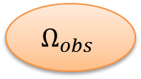






= target
= defender
= attacker
= obstacles
$$∂Ω$$
$$Ω_{free}$$
$$D_{1},…,D_{n}$$
$$Ω_{obs}$$
$$Ω$$
$$𝒯$$
$$A_{1},…,A_{n}$$
$$Ω_{obs}$$

